Slide 1
IBM Blockchain Platform 2 on Redhat OpenShift Container Platform IBP 2 on OCP
Final state
Setup IBP 2.0
Blockchain Platform Manager Role
Deploy the network
Using Visual Studio Extension
Invoke a sample transaction
Teardown the network

Slide 2
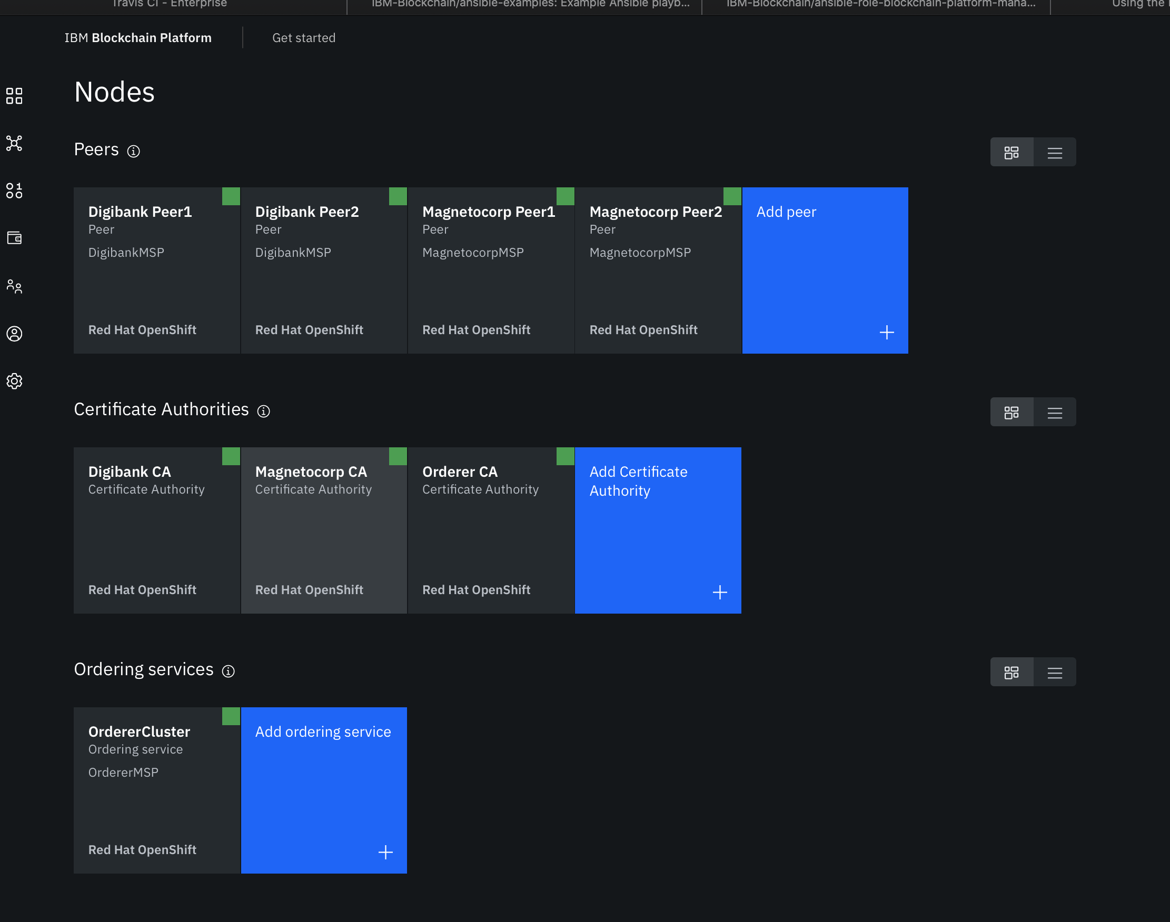
IBP 2 on OCP
Final state

Slide 3
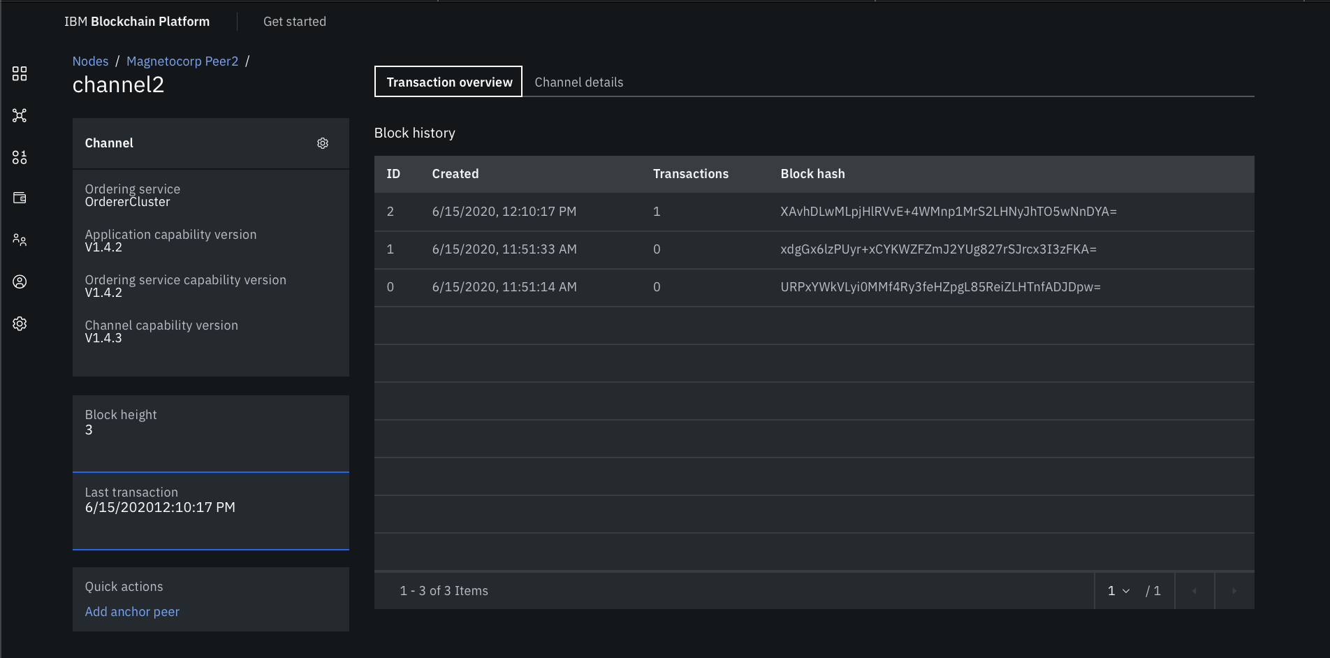
IBP 2 with OCP
Final state

Slide 4
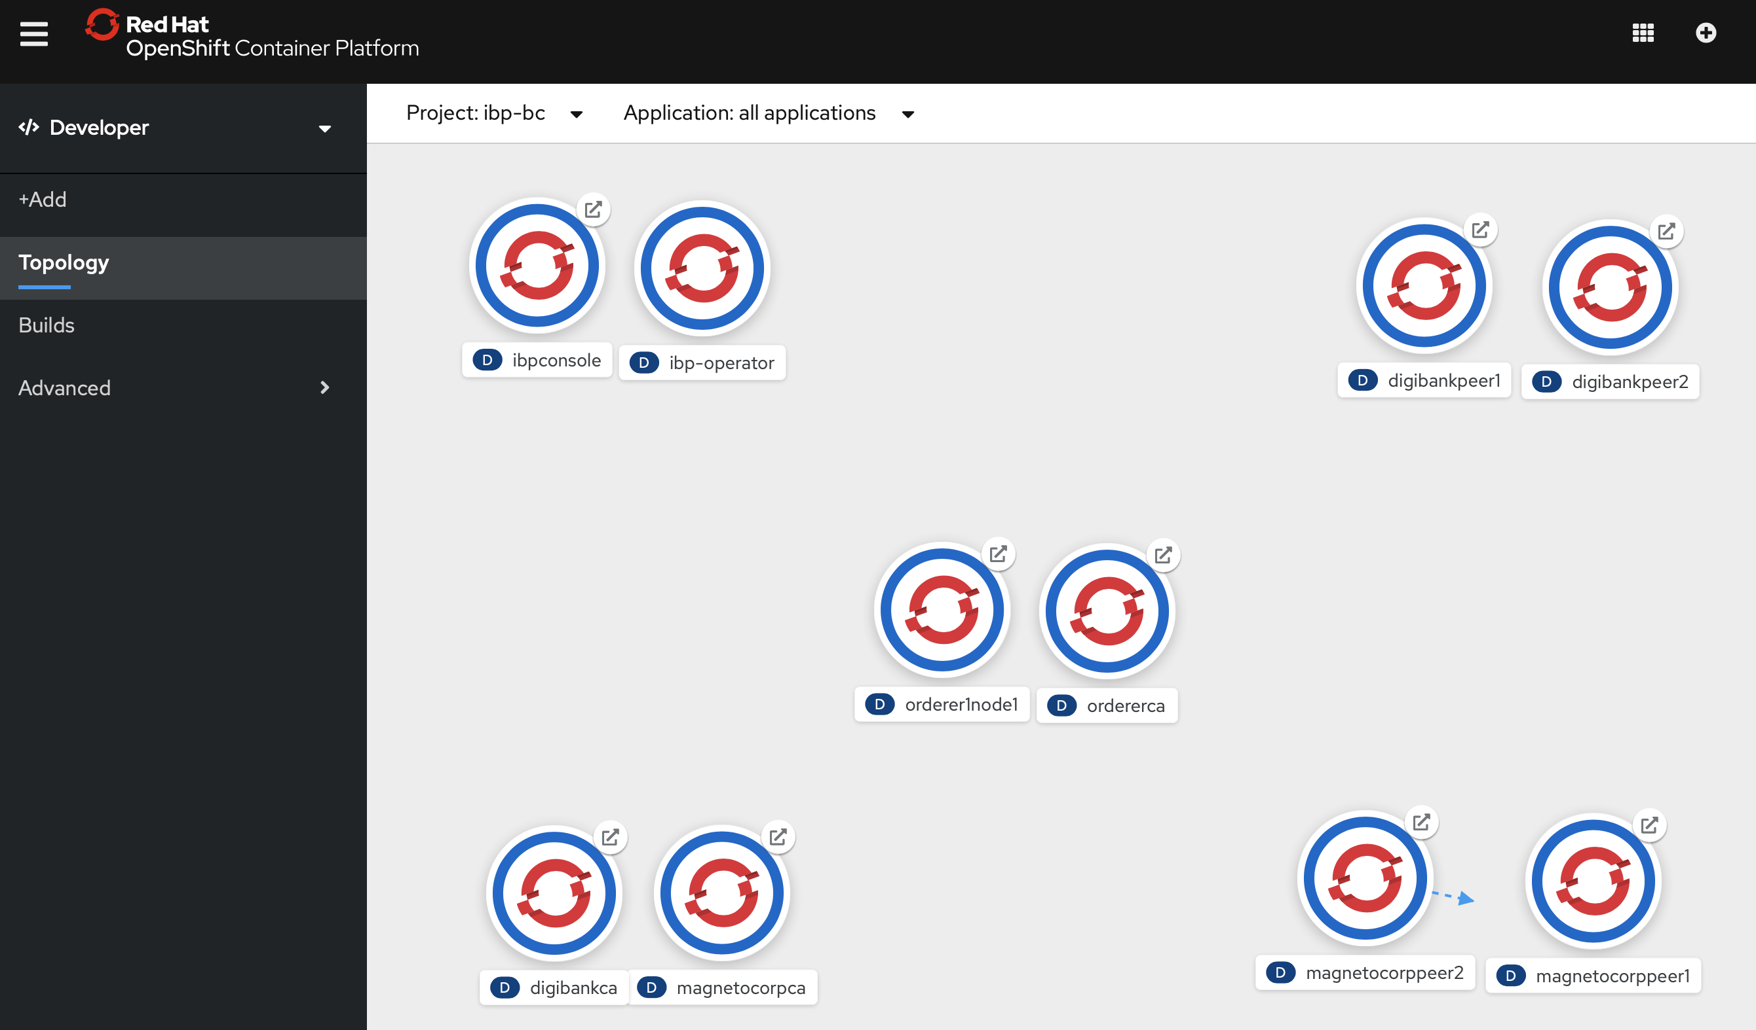
OCP Topology
IBP 2 on OCP
Final state
Order CA and Orderer
Magnetocorp CA, Peer 1 and Peer 2
DigiBank CA, Peer 1 and Peer 2

Slide 5
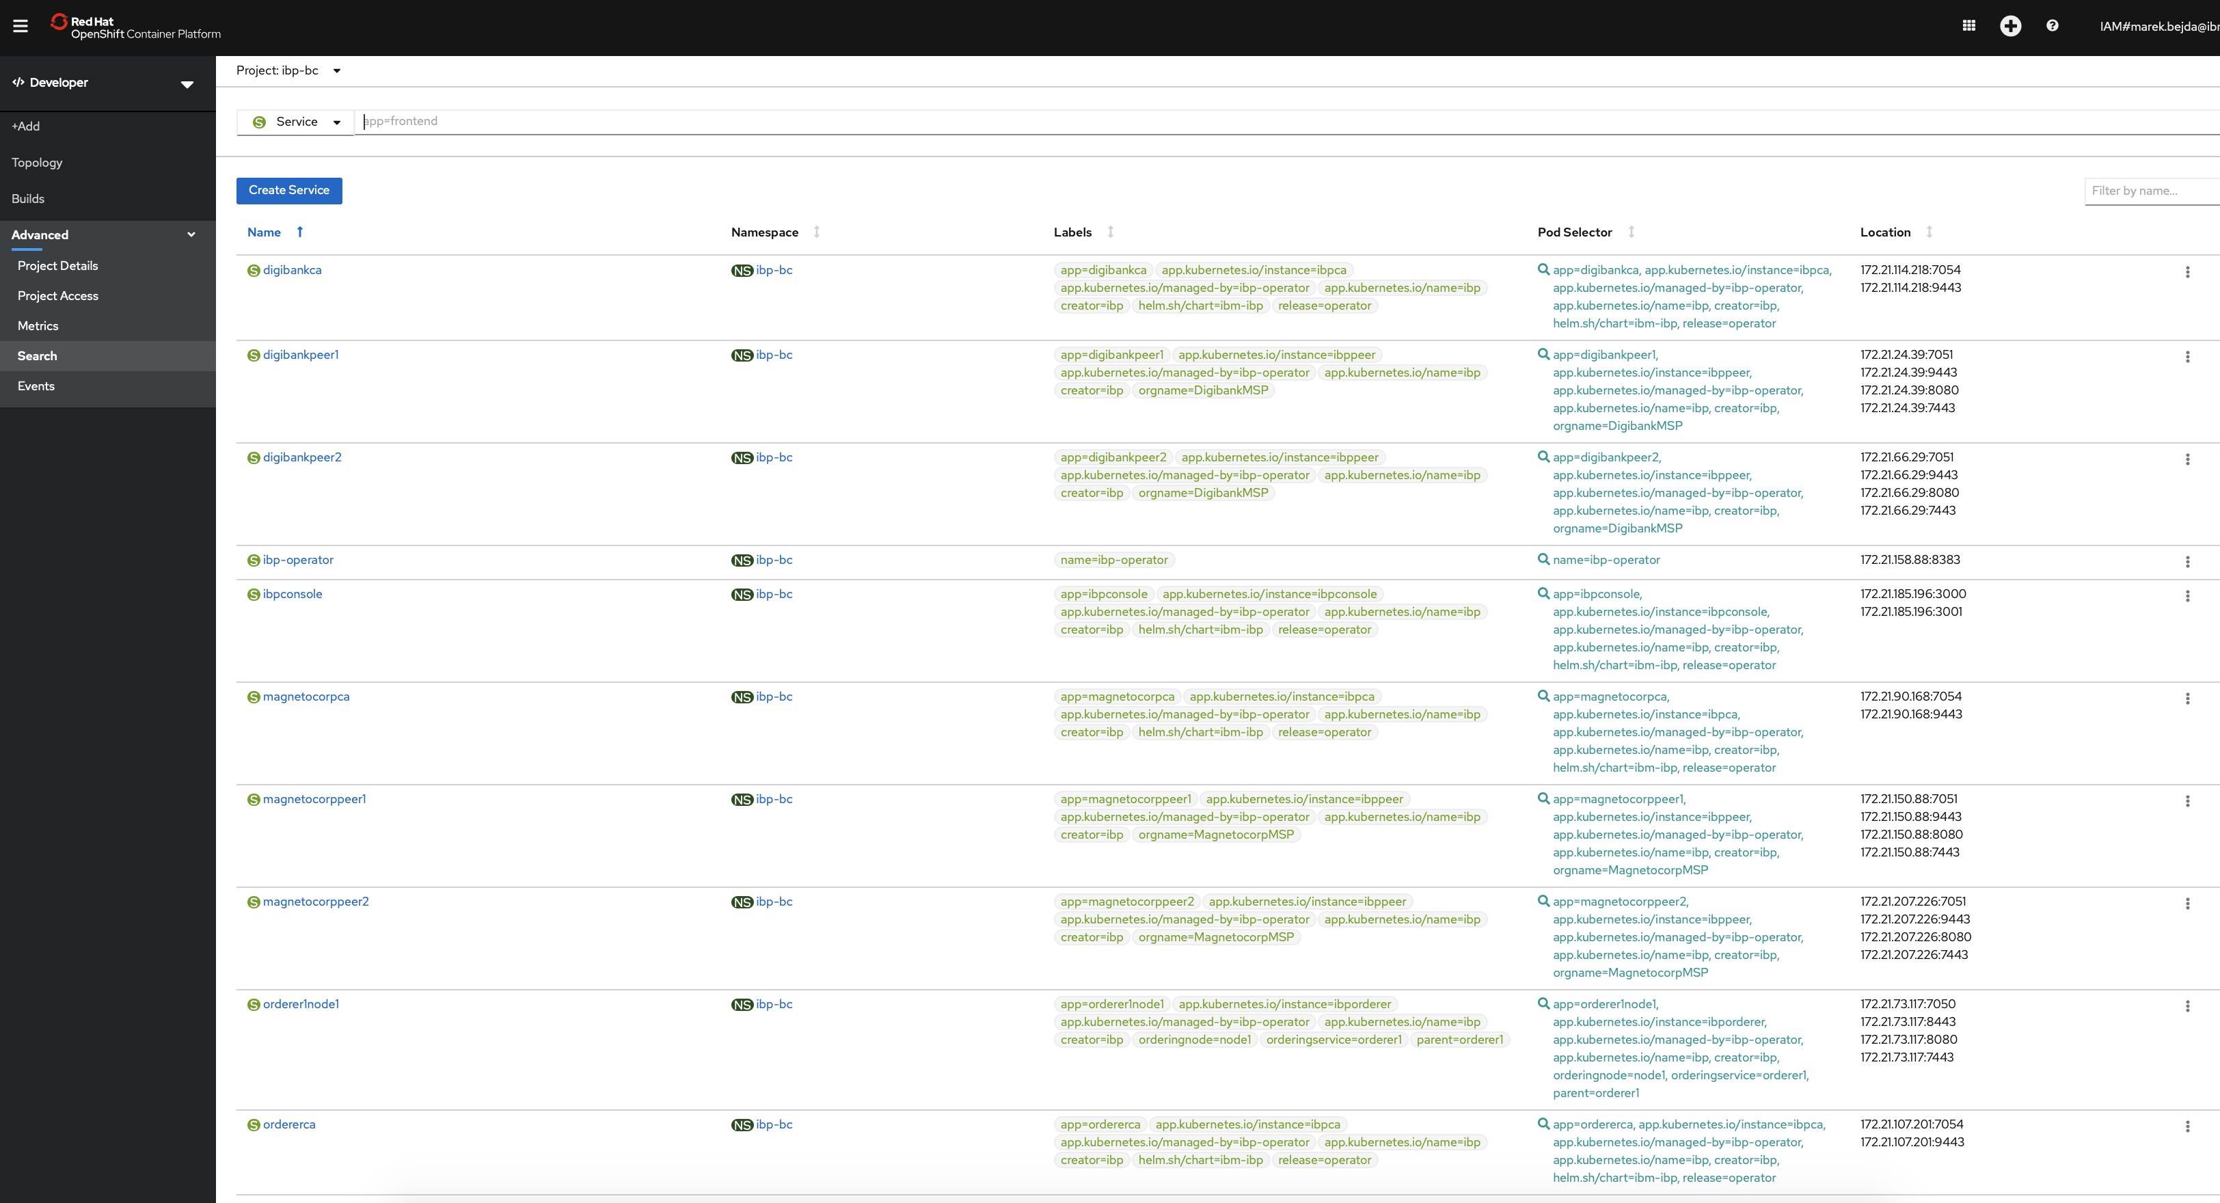
IBP 2 on OCP
Final state

Slide 6
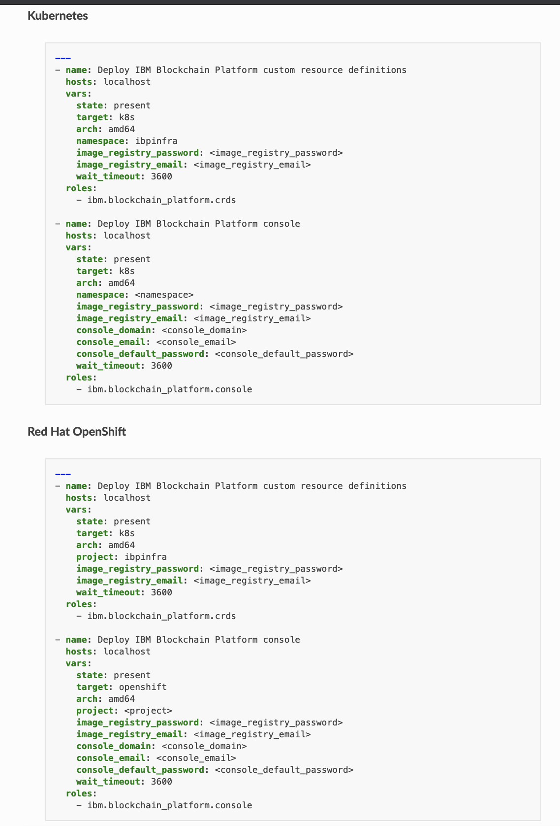
Setup IBP 2.0
IBP 2 with OCP
Setup IBP 2.0
https://ibm-blockchain.github.io/ansible-collection/tutorials/installing.html#creating-the-playbook
Create a new Ansible playbook file called install-ibp.yml. Copy and paste the content for Kubernetes or Red Hat OpenShift into this new playbook, depending on the type of cluster that you are using:

Slide 7
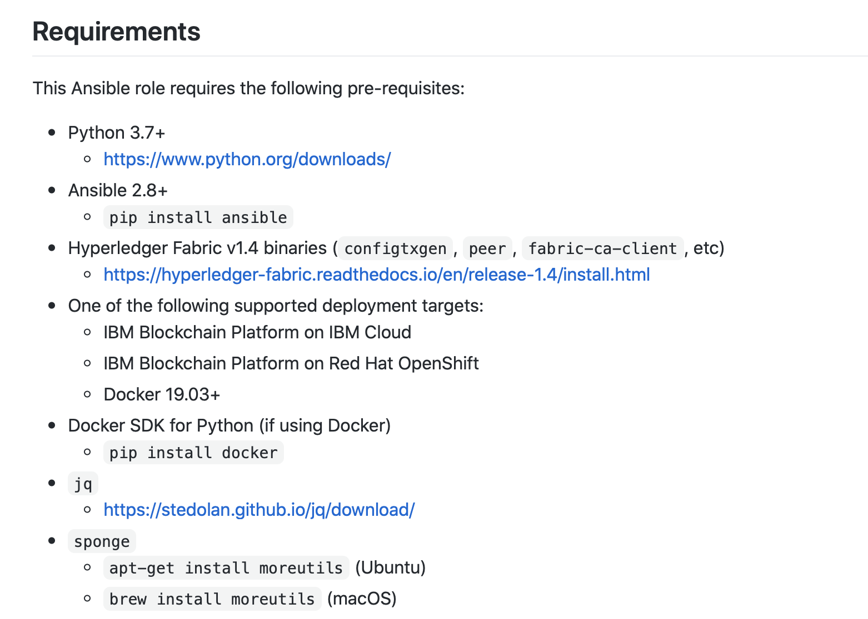
Ansible Role – Blockchain Platform Manager
IBP 2 on OCP
Blockchain Platform Manager
URL: https://github.com/IBM-Blockchain/ansible-role-blockchain-platform-manager#requirements

Slide 8
IBP 2 on OCP
Ansible installation
https://docs.ansible.com/ansible/latest/installation_guide/intro_installation.html
Setup IBM Blockchain Platform Manager
https://galaxy.ansible.com/ibm/blockchain_platform_manager
$ ansible-galaxy install ibm.blockchain_platform_manager

Slide 9
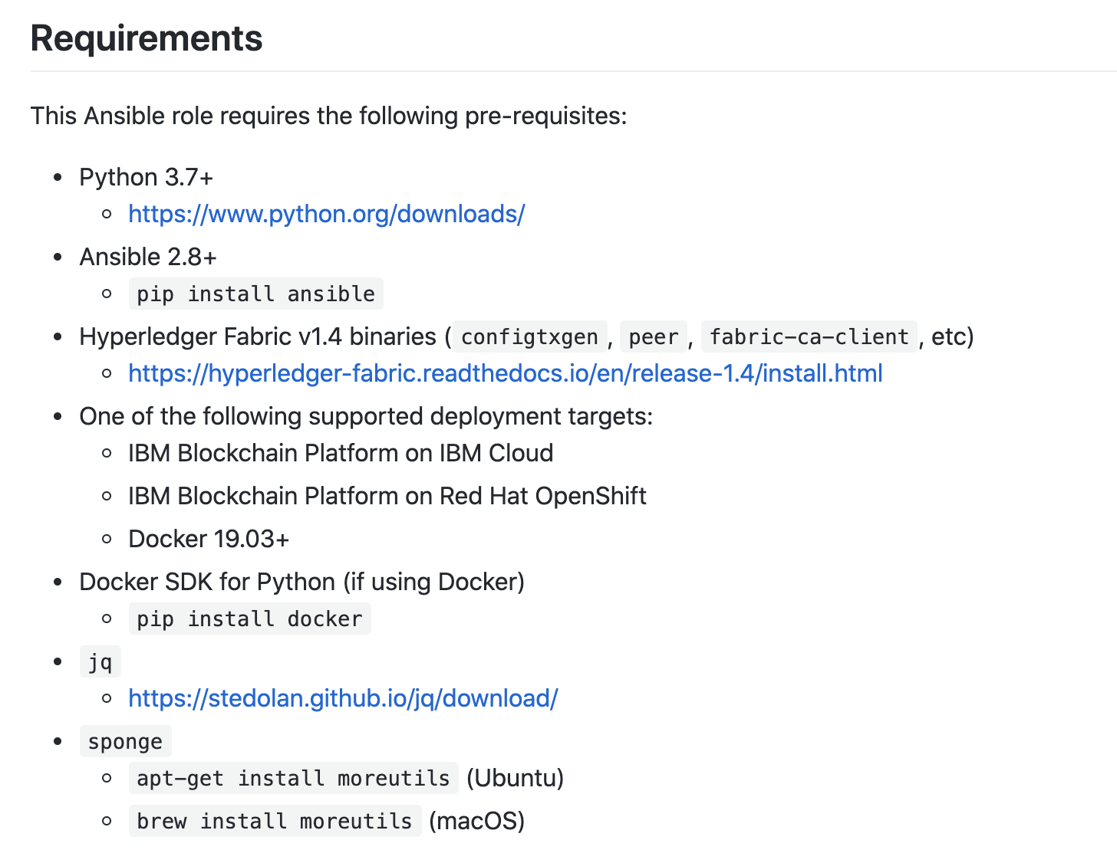
Additional dependencies - Fabric Tools, Sponge, jq
IBP 2 on OCP
https://hyperledger-fabric.readthedocs.io/en/release-2.0/install.html
The ansible playbook depends on the local machine having access to certain fabric binaries like fabric-ca-client
1. We can grab the Fabric tools binaries using these commands:
$ curl -sSL https://bit.ly/2ysbOFE > fabric_tools.sh $ chmod +x fabric_tools.sh $ fabric_tools.sh -s -d
$ export PATH=`pwd`/fabric-samples/bin:$PATH
2. Jq can be installed using (https://stedolan.github.io/jq/download/)
$ sudo apt-get install jq
OR
$ brew install jq
3. Sponge can be installed:
$ sudo apt-get install moreutils
OR
$ brew install moreutils

Slide 10
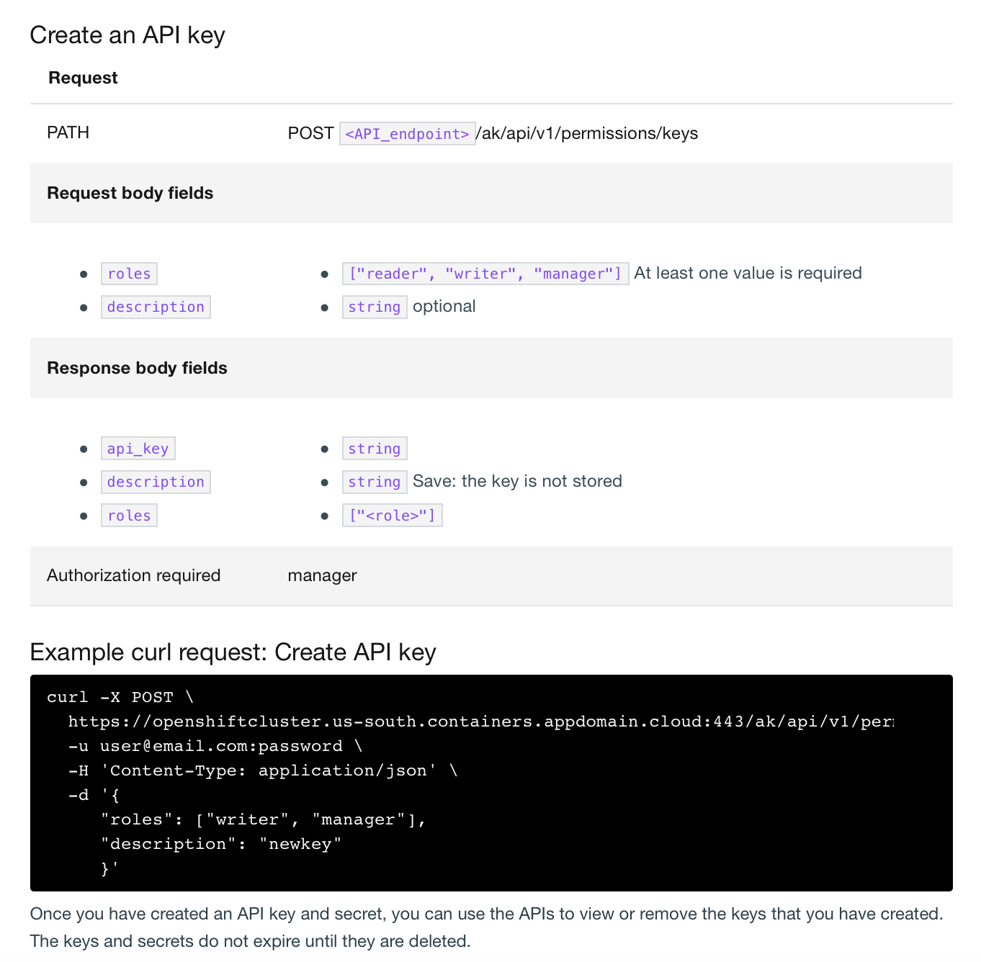
Generate an IBP 2- API Key
IBP 2 on OCP
Deploy the network
Create IBP API Key for playbook
https://cloud.ibm.com/docs/blockchain-multicloud?topic=blockchain-multicloud-ibp-v2-apis#console-icp-manage-create-api-key

Slide 11
Deploy the network
IBP 2 on OCP
Deploy the network
https://github.com/IBM-Blockchain/ansible-examples/blob/master/two-org-network/playbook.yml
For OCP change the infrastructure to software and insert the API key information
Specify the Chaincode –------------------------------------>
This step takes about 30 minutes…if it fails retry
infrastructure:
type: software
docker:
network: ibp_network
software:
api_endpoint: https://ibp-bc-ibpconsole-console.aais-1589822809013-f72ef11f3ab089a8c677044eb28292cd-0000.us-east.containers.appdomain.cloud:443
api_key: kIiFKz3GmifjkOp3XX
api_secret: U0Ne8OPMI_XX
contracts:
- name: papercontract
version: 0.0.1
package: "{{ playbook_dir }}/papercontract@0.0.1.cds"
channels:
- <<: *Channel1
endorsement_policy: "OR('DigibankMSP.member','MagnetocorpMSP.member’)”
endorsing_members:
- <<: *Digibank
endorsing_peers:
- <<: *DigibankPeer1
- <<: *Magnetocorp
endorsing_peers:
- <<: *MagnetocorpPeer1
$ ansible-playbook playbook.yml

Slide 12
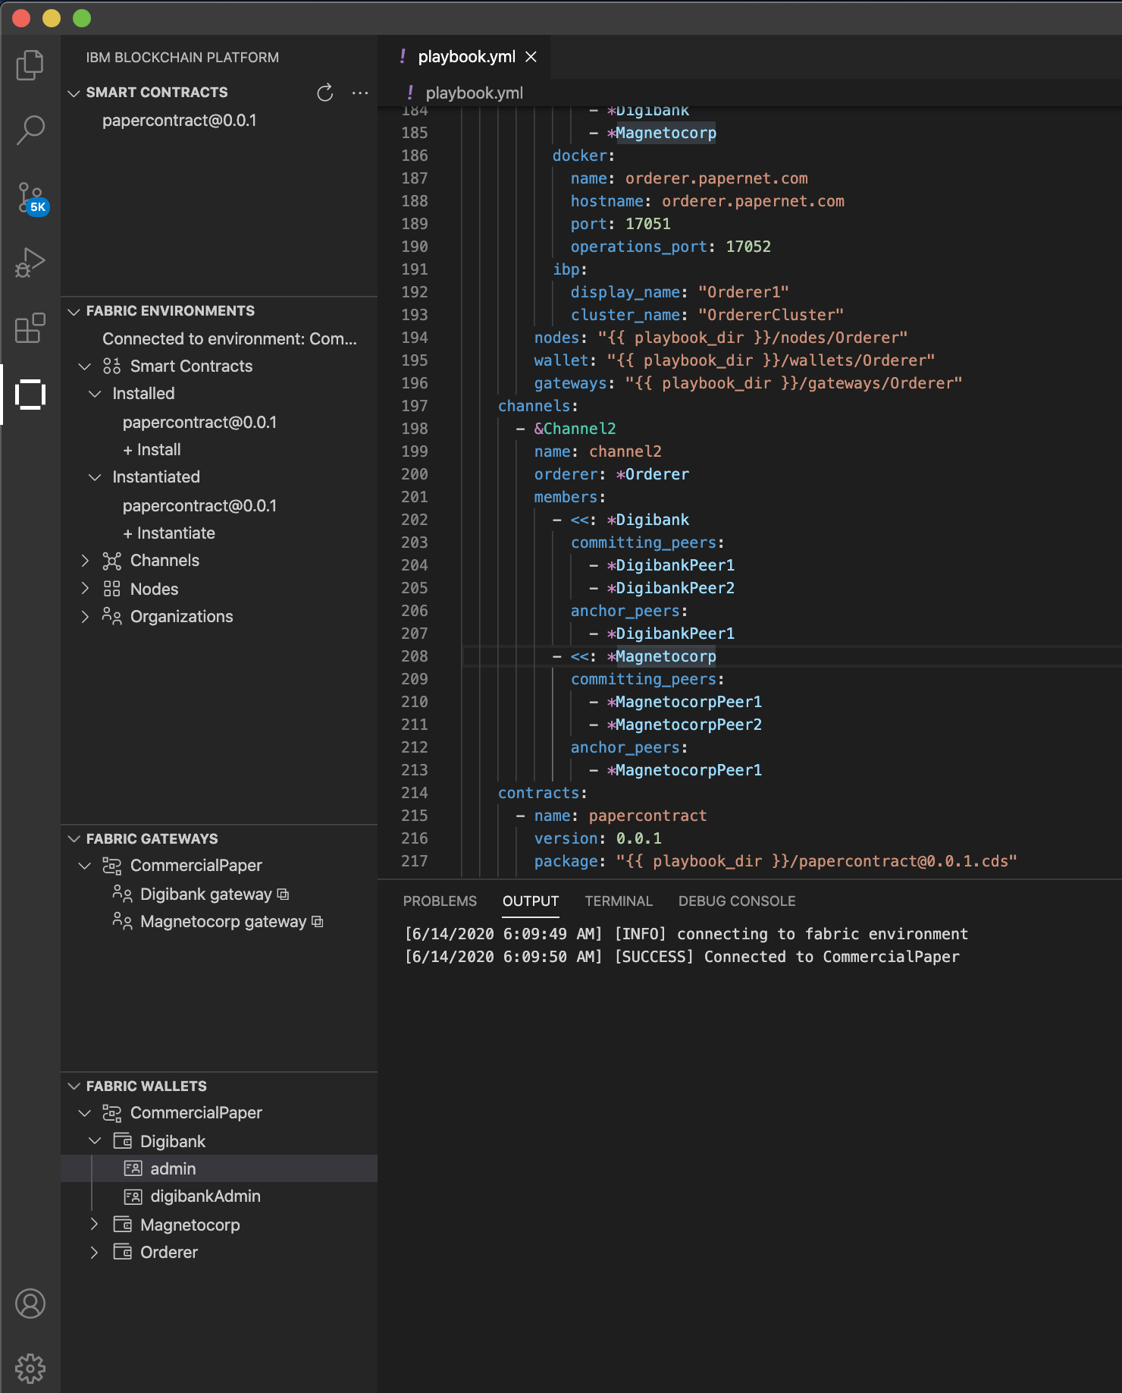
Using Visual Studio Extension
IBP 2 on OCP
Deploy the network
Information on the available nodes (peers, orderers, and certificate authorities) will be created under the nodes subdirectory.
If you wish to use this network for development purposes, you can import these JSON files into a Fabric Environment using the IBM Blockchain Platform extension for Visual Studio Code.
For more information on this task, follow the process to create a new Fabric Environment documented here: https://github.com/IBM-Blockchain/blockchain-vscode-extension#connecting-to-another-instance-of-hyperledger-fabric
Fabric Environments click +
In the menu that appears select ”Add an Ansible-created network”
Select the folder where you executed the “ansible-playbook” command

Slide 13
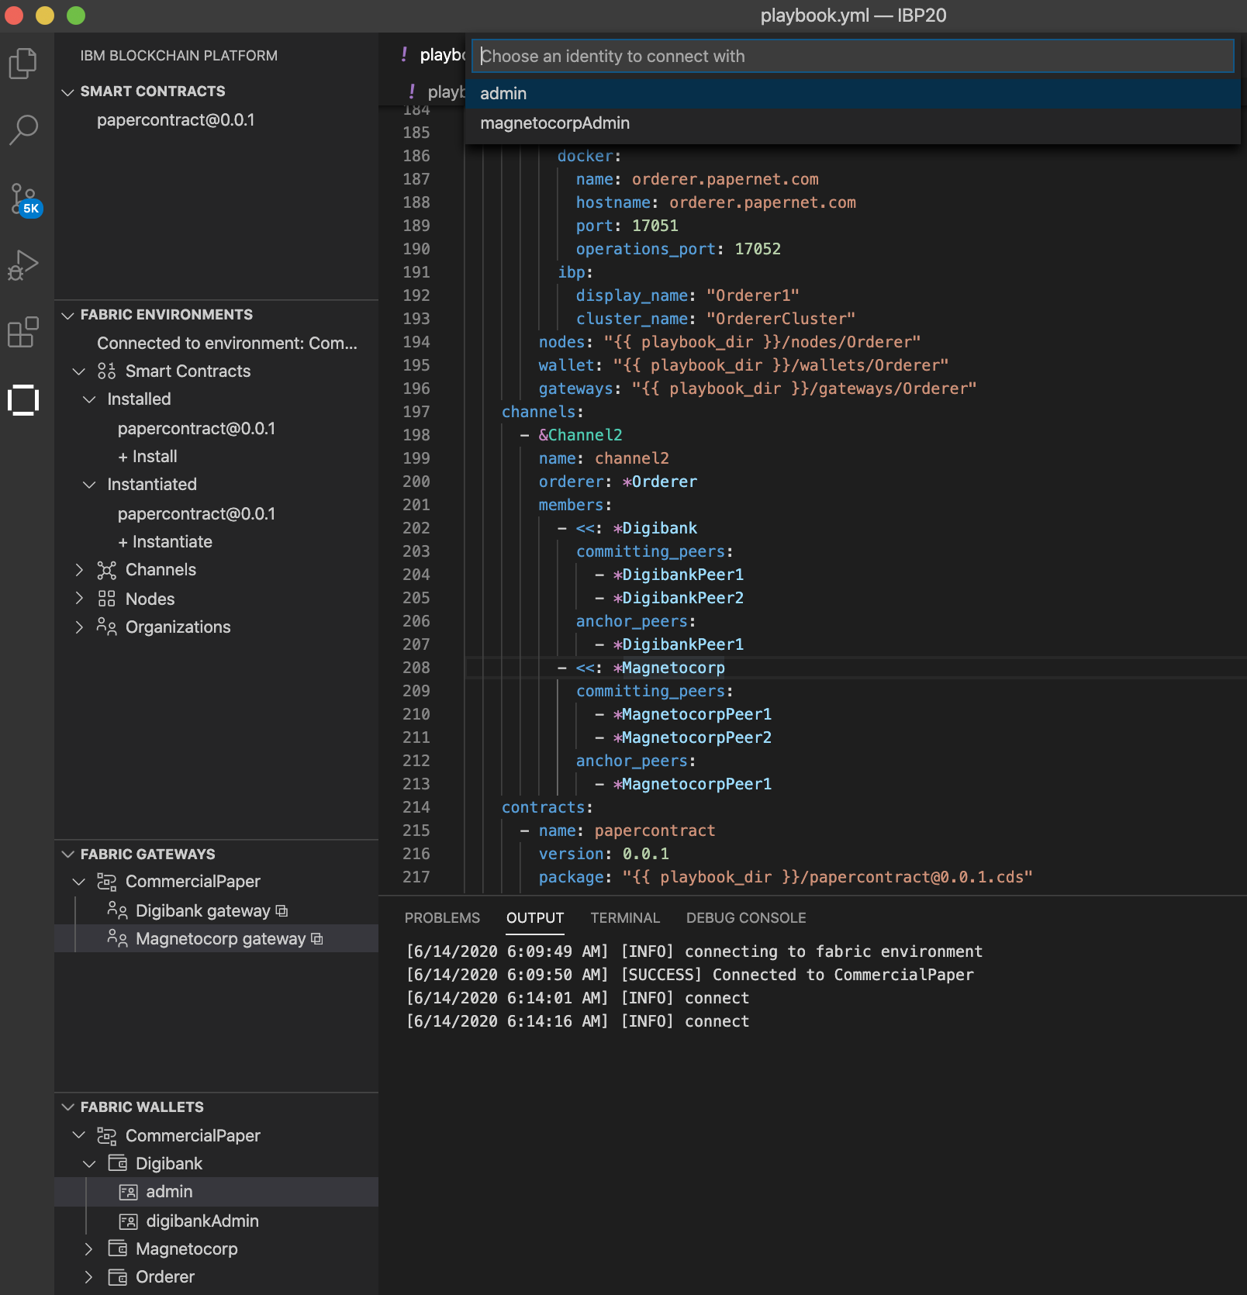
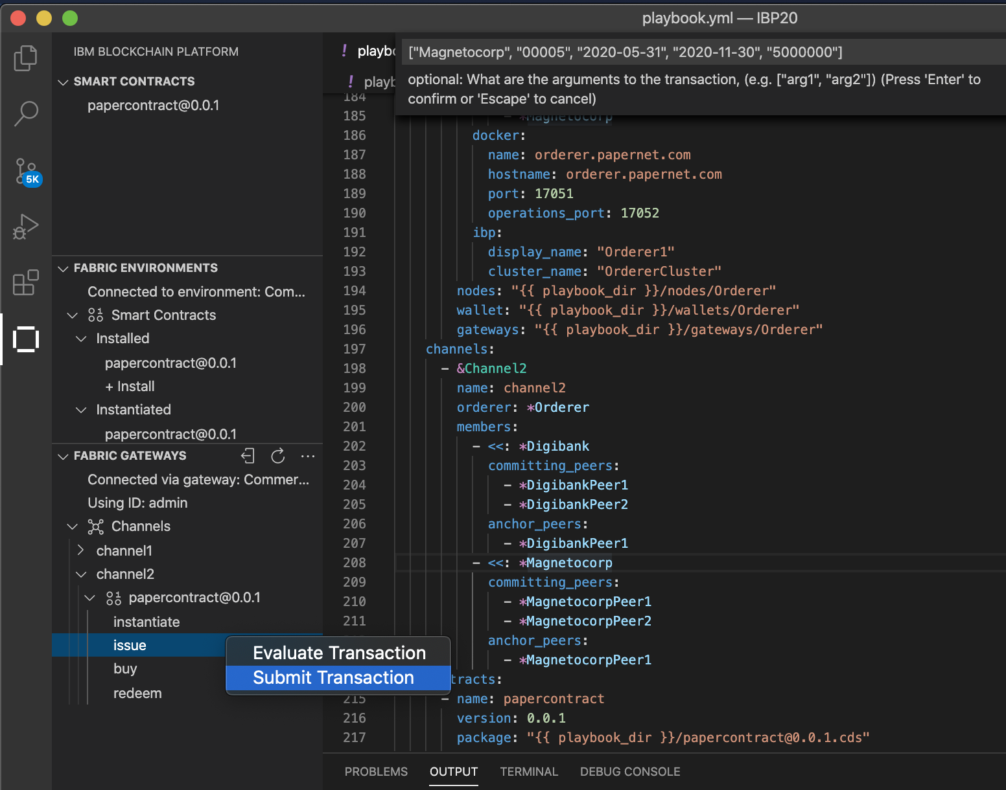
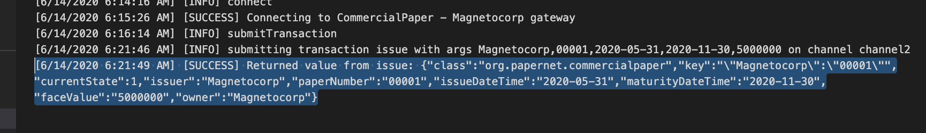
Invoke a sample transaction
IBP 2 on OCP
Visual Studio Code
2
Select a Fabric Gateway (Magnetocorp gateway)
Select credentials to connect as (admin)
Navigate to contract
Right click issue and Submit Transaction
Put in the transaction information
["Magnetocorp", "00001", "2020-05-31", "2020-11-30", "5000000"]
Once submitted you should see success in the console.
5
1
3
4

Slide 14
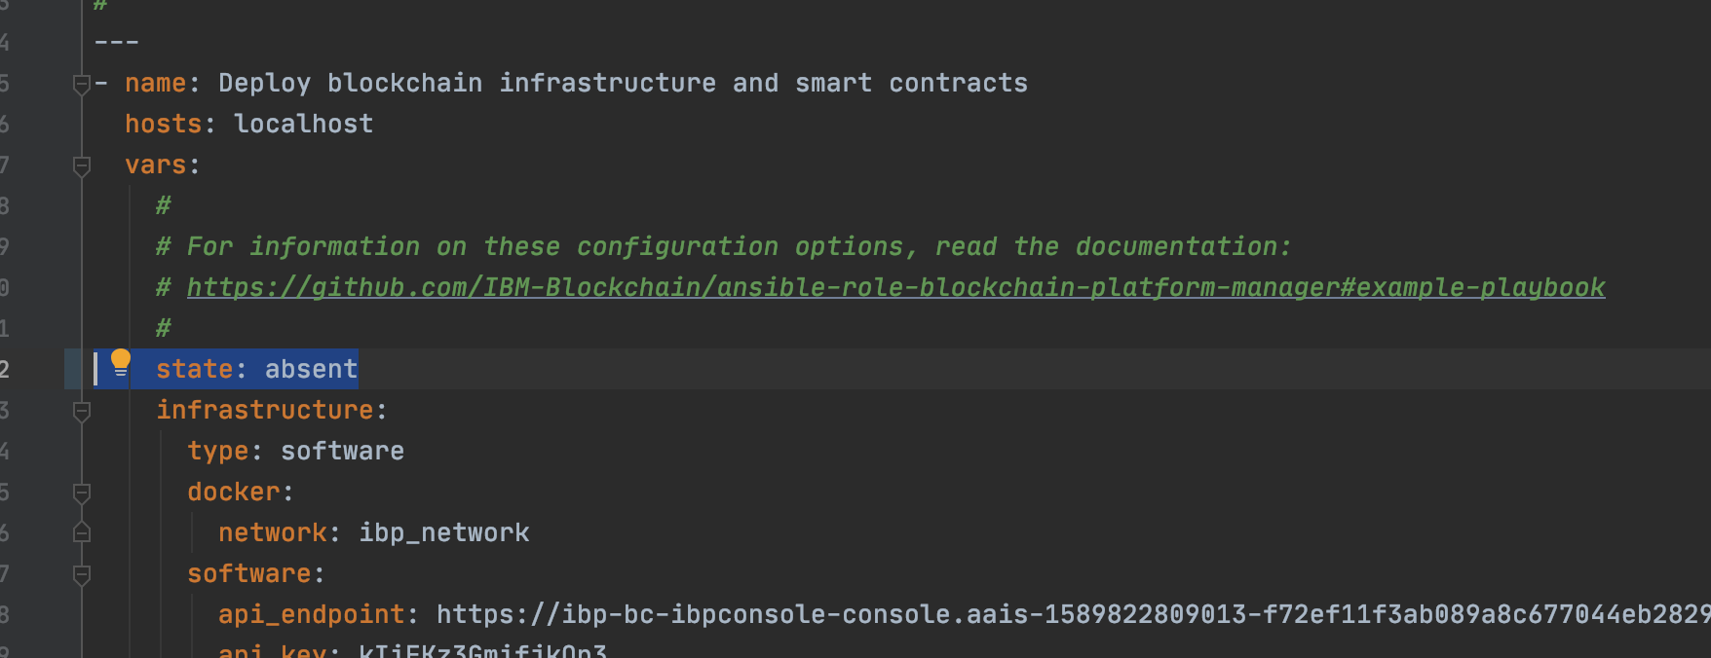
Optional: Teardown the network
IBP2 on OCP
Deploy the network
To teardown the network and remove deployed resources in the playbook change the state to absent.
There’s a good chance the Persistent volumes will not be removed you may need to remove them manually.
$ oc get pv
NAME CAPACITY ACCESS MODES RECLAIM POLICY STATUS CLAIM STORAGECLASS REASON AGE
pvc-133d3c85-2bb1-4e20-8c96-2136083d91aa 100Gi RWO Retain Released ibp-bc/magnetocorppeer1-pvc 7m57s
pvc-32adbb89-887d-4344-baf5-39d3d9221d5f 100Gi RWO Retain Released ibp-bc/magnetocorppeer2-statedb-pvc 2m58s
pvc-66e696d4-3168-4724-8dd4-4b4a193d09e9 100Gi RWO Retain Released ibp-bc/digibankpeer1-pvc 19m
Delete the PVs with
$ oc delete pv/pvc-133d3c85-2bb1-4e20-8c96-2136083d91aa

Slide 15
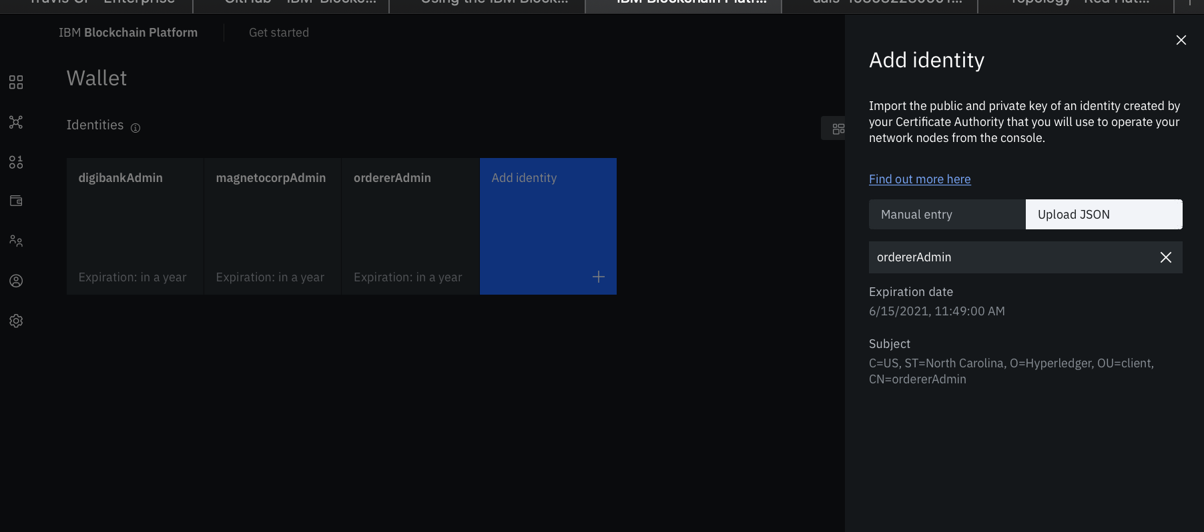
IBP 2 on OCP
Add identities to IBP 2

Slide 16
Next steps
IBP 2 on OCP
Nest steps
Travis CI deployment of network

Slide 17
References
IBM Blockchain – Ansible examples
https://github.com/IBM-Blockchain/ansible-examples/tree/master/two-org-network
Ansible Blockchain Platform Manager
https://github.com/IBM-Blockchain/ansible-role-blockchain-platform-manager#requirements
Create an IBP API Key
https://cloud.ibm.com/docs/blockchain-multicloud?topic=blockchain-multicloud-ibp-v2-apis#console-icp-manage-create-api-key

